Slide 1


DHE Learning Outcomes Assessment Update
Dr. Lane Glenn, President, Northern Essex Community College
Dr. Robert J. Awkward, Director of Learning Outcomes Assessment
Dr. Patricia A. Marshall, Deputy Commissioner for Academic Affairs & Student Success
Community College Council of Presidents
February 22, 2019

Slide 2
Brief History
Student Learning Outcomes Assessment
External factors
Have faculty drive assessment
Avoid standardized tests
Address lack of assessment culture
Create assessment initiative
Working Group on Student Learning Outcomes and Assessment established the following in January 2010:

Slide 3

Massachusetts Organizing Structure
Student Learning Outcomes Assessment
Massachusetts Task Force on
Statewide Assessment
Chair: Dr. Lane Glenn, President,
Northern Essex Community College
Providing broad oversight for Massachusetts
State Level
Amcoa Team
Advancing assessment of student learning on public campuses; strengthening campus
assessment capabilities
Facilitator: R. J. Awkward
VALUE Steering Committee
Representing MA in the VALUE Institute/MSC to develop a multistate program of assessment
Director: R. J. Awkward

Slide 4

Convening
AMCOA Team
Pending (at QCC):
  Fri., April 5 (11am-1pm): Program TBD
Completed (all at QCC):
  Fri., Sept. 28: “Institutional Assessment Program Panel: Learning from Our Peers: UMass Amherst, Framingham State University, & Northern Essex Community College”
  Fri., Nov. 30: Dr. Patricia O’Brien, SND, Sr. Vice President, and Dr. Laura Gambino, Vice President of the New England Commission for Higher Education
  Fri., Feb. 1: Quinsigamond Outcomes Research for Excellence Team & Assessing Oral Presentations

Slide 5
Convening
Task Force for Statewide Assessment
Pending (at QCC):
  Fri., March 1: Program TBD
Completed (all at QCC):
  Oct. 16: Dr. James Dottin, Chair, Business Administration Department, Middlesex Community College; “Program Assessment from the Lens of a Department Chair: A Journey from Compliance to Engagement”
  Jan. 17: Dr. Emily Williams, Vice President of Academic Affairs, Massachusetts College of Liberal Arts; “Assessment Across Regions: Lessons Learned”

Slide 6

Annual Assessment Conference
Eighth Annual Assessment Conference on April 19, 2019 from 8:00am – 3:00pm at the Best Western Royal Plaza Hotel & Trade Center, Marlborough, MA
National guest presenter:
    Dr. Gianina Baker, Assistant Director, National Institute for Learning Outcomes Assessment (NILOA) on the Intersectionality of Equity and Assessment
Expert workshop presenters from colleges and universities.
Two tracks: new assessment approaches and building assessment skills
Conference should be attended by teams of faculty, teaching & learning center directors, assessment leaders and administrators.

Slide 7
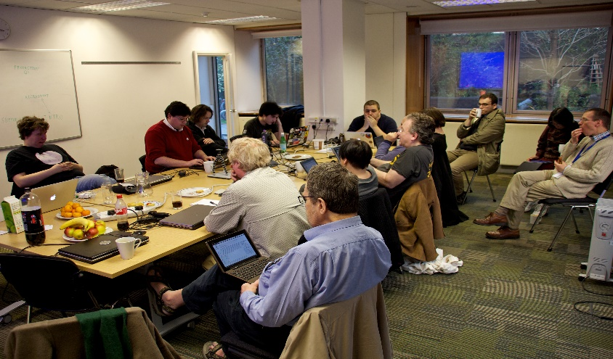
Faculty Development
Regional Professional Development
Assignment Design & Rubric Alignment Charrettes
  Objectives: Improve student learning, links learning & teaching with assessment, better data, and equity
  Expected Outcomes: Increase participation in VALUE Institute, create more effective assignments, and employ the use of TILT design
  Incentives for attendance: Hands-on session using their own assignment, held on Friday, and food/refreshments
  Regionally located:
    North Region at North Shore Community College on November 2 (9am – 1pm)
    Boston Metro Region at UMass Boston on Friday, December 7 (9am – 1pm)
    Central Region at Worcester State University, January 25, 2019 (12:00 – 4pm)
    Western Region at Westfield State University, February 8, 2019 (9am – 1pm)
  Use of local assessment leaders as faculty (Dr. Bonnie Orcutt and Dr. Sarah Strout, Worcester State University)

Slide 8

Professional Development
Building an Effective Assessment Program for Institutional Teams
  Friday, May 10, 2019 from 9am – 3pm.
  Quinsigamond Community College, Room 109 A& B, Harrington Learning Center
  Focus will be for institutional teams of up to eight to develop or strengthen their assessment program
  Facilitator: Dr. Mark Nicholas
  Executive Director, Institutional Assessment
  Framingham State University
  Food and refreshments to be provided

Slide 9

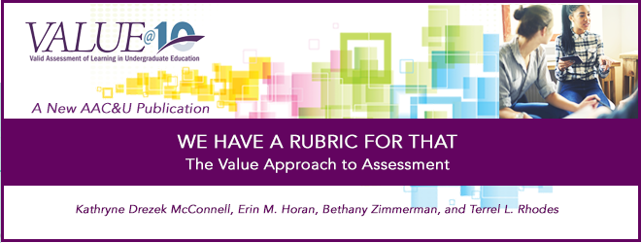
VALUE Institute (nee MSC)
Chronology:
  Massachusetts Pilot Assessment (2013-2014)
  Massachusetts Pilot II/Multi-State Collaborative Pilot (2014-2015)
  Multi-State Collaborative to Advance Quality Student Learning: Demonstration Year (2015-2016)
  Multi-State Collaborative to Advance Quality Student Learning: Refinement Year (2016-2017)
  Multi-State Collaborative to Advance Quality Student Learning: Refinement Year 2.0/VALUE Institute Inaugural Year (2017-2018)
  VALUE Institute Second Year
  (2018-2019)

Slide 10
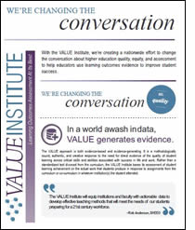

Common Framework
Student Learning Outcomes Assessment
Authentic Student Work
LEAP Essential Learning Outcomes
  Critical & Creative Thinking
  Quantitative Literacy
  Written & Oral Communication
LEAP VALUE Rubrics
Multi-State Collaborative (MSC) to VALUE Institute
  Public only, free
  Public and private, fee-for-service

Slide 11
Massachusetts Compared to Project Level Data: 2017 vs. 2016
VALUE Rubrics | Two-Year Institutions | Four-Year Institutions
Critical Thinking | + | +
Written Communication | + | +/-
Quantitative Literacy | -/+ | -

Slide 12
Suggested Items for Individual Campuses & Statewide Action
More activities related to Written Communications in 3rd and 4th year courses, programs, and majors (except in Syntax and Mechanics)
Resume or enhance existing “writing across the curriculum” activities
Increase activities related to Quantitative Literacy in 3rd and 4th year courses, programs, and majors
Employ quantitative literacy across the curriculum in addition to general education courses
DHE to provide regional assignment design workshops for faculty linked to VALUE Rubrics to improve teaching effectiveness, increase student learning, and improve outcomes results in 2018-2019
DHE to provide training for faculty on how to employ Quantitative Literacy in curriculum at all levels by launching regional Quantitative Literacy faculty workshops in 2018-2019 (deferred to Fall 2019)

Slide 13

2019 AAC&U Annual Meeting
Raising Our Voices: Reclaiming the Narrative on the Value of Higher Education
January 23 – 26, 2019
Hyatt Regency Atlanta
Pre-conference – VALUE 10: A Decade of VALUE and the Future of Higher Education
Workshop Session - Leading from Experimentation: The Massachusetts System Story

Slide 14



MassTransfer Pathways Student Learning Outcomes
Carryover from AY 2018
Business Administration
Criminal Justice
Early Childhood Education
New for AY 2019
Elementary Education
Engineering
Fine Arts & Graphics
General Education – Thurs. 2/28:
  Behavioral & Social Sciences
  Humanities & Fine Arts
  Natural & Physical Sciences
  English Composition/Writing
  Math

Slide 15

Open Educational Resources (OER) Working Group
Kickoff meeting held Monday, November 26, 2018 at Quinsigamond Community College
Next meeting was held on Friday, February 15 at Quinsigamond Community College
Definition: OER means teaching, learning and research materials in any medium – digital or otherwise – that reside in the public domain or have been released under an open license that permits no-cost access, use, adaptation and redistribution by others with no or limited restrictions.
Conducted and analyzing an OER Prevalence Survey. 100% participation!
Timetable – Complete work by early April 2019
Stakeholders | 12/21, 1/18, 1/31
Marketing & Communications | 12/28, 1/17, 2/20
OER Infrastructure | 12/19, 1/23
Policy Development/Legislative | 1/4, 1/18, 2/6, 2/22
Faculty Development | 1/8, 1/22, 2/5, 2/26 (upcoming)

Slide 16
OER Working Group Members
Emily Alling, Associate Dean of Library, Massachusetts College of Liberal Arts
Matt Bejune, Executive Director, Libraries, Worcester State University
Marilyn Billings, Head, Office of Scholarly Communications Library, University of Massachusetts Amherst, Co-Chair
LaDonna Bridges, Associate Dean of Academic Success, Framingham State University
Barry Brown, Follett Bookstore Manager and Adjunct English Faculty, Middlesex Community College
Jody Carson, Associate Professor of Early Childhood Education, Northern Essex Community College
Cherie Comeau, Sr. Manager, Leadership & Organizational Development, Consigli Construction Co., Inc.
Eileen Cusick, Associate Professor of Information Technology, Springfield Technical Community College
Catherine Sughrue Etter, Professor of Science, Cape Cod Community College
Millie Gonzalez, Interim Chief Diversity & Inclusion Officer, Framingham State University
George Hart, Director of Libraries, University of Massachusetts Lowell

Slide 17
OER Working Group Members
Karen Hines, Associate Professor of Business & Technology, Holyoke Community College
Elizabeth McKeigue, Executive Director, Libraries, Salem State University
Apurva Mehta, Associate Chief Information Officer, University of Massachusetts Boston
Arlene Rodriquez, Vice President of Academic Affairs, Cape Cod Community College
Donna Maturi, Coordinator of Library Services, Professional Development, Middlesex Community College
Jeremy Smith, Digital Project Manager, University of Massachusetts Amherst
Susan Tashjian, Coordinator of Instructional Technology, Northern Essex Community College, Co-Chair
Margaret Wong, President, Massachusetts Community College Council; Professor of English, Quinsigamond Community College
Two student representatives from the Student Advisory Council: Morgan Mayo (Middlesex Community College) and Nick Papa (Salem State)

Slide 18

Stakeholder Communications
Joint Meeting of the Community College Presidents and Chief Academic Officers
Friday, February 22
Middlesex Community College
Update on the Status of Statewide Assessment by:
  Dr. Lane Glenn, President, Northern Essex Community College & Task Force for Statewide Assessment Chair
  Dr. Patricia Marshall, Deputy Commissioner for Academic Affairs & Student Success
  Dr. Robert Awkward, Director of Learning Outcomes Assessment

Slide 19
Questions…Comments?
Thank You!!

